Slide 1
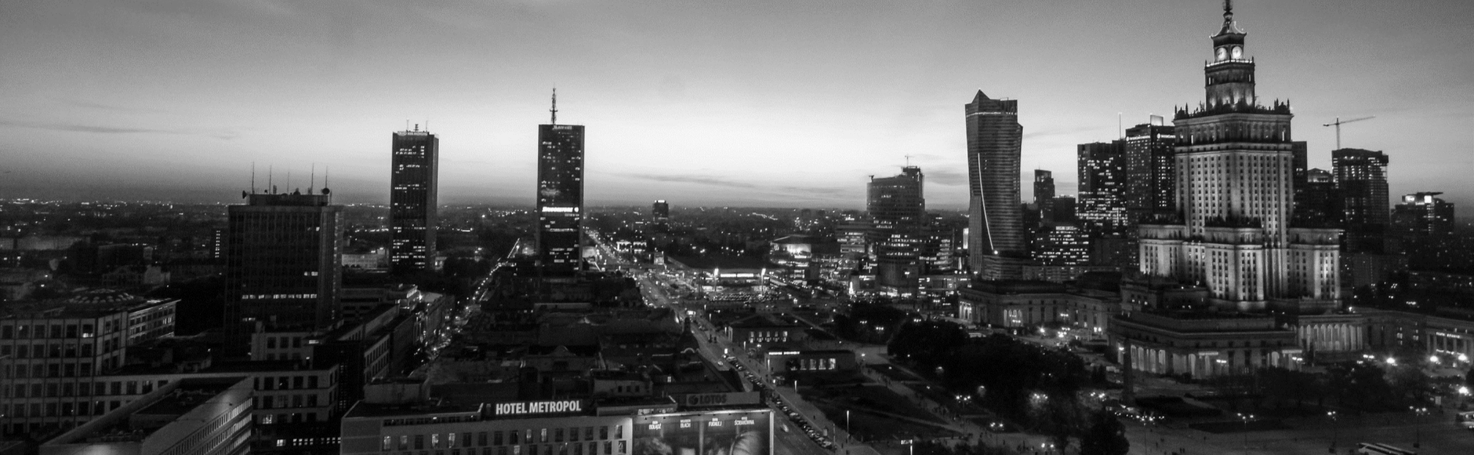
JD AI Fashion-Challenge时尚风格识别
北科801 队伍 技术报告
报告人：司泽 学校：北京科技大学

Slide 2
01、问题描述
目录
CONENTS
Problem Description
02、方法介绍
Method Introduction
03、存在的问题
Unresolved issue

Slide 3
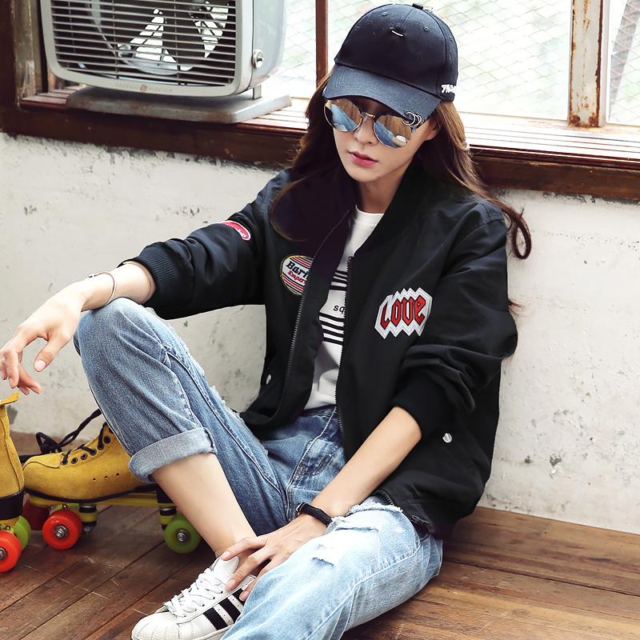
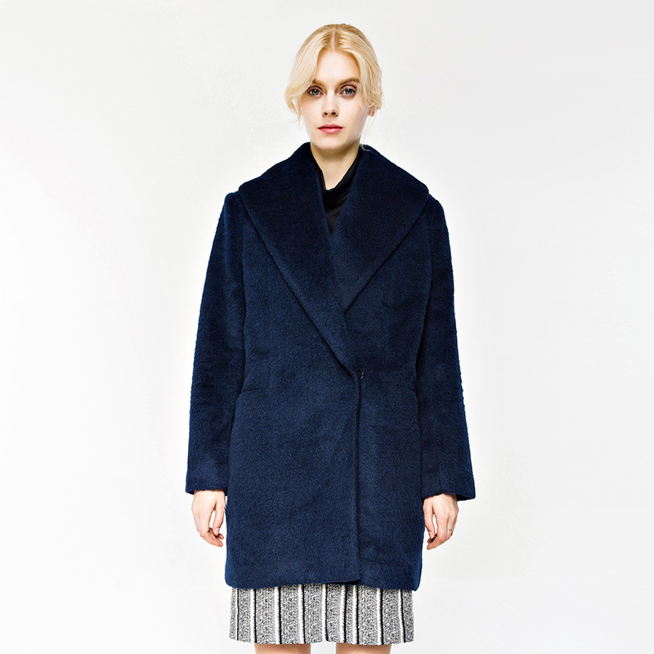
01
问题描述
时尚风格识别
Fashion Style Recognition
休闲 街头
通勤 欧美 淑女

Slide 4
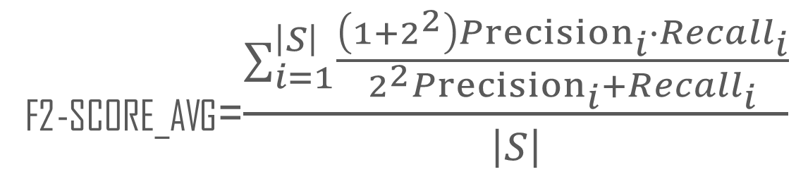
评判标准：各标签的F2-score均值
标签i的精确率
标签i的召回率
F2-SCORE_AVG=$\frac{∑_{i=1}^{\left|S\right|}\frac{\left(1+2^{2}\right){Precision}_{i}∙{Recall}_{i}}{2^{2}{Precision}_{i}+{Recall}_{i}}}{\left|S\right|}$
S={运动,休闲,OL/通勤,日系,韩版,欧美,英伦,少女,名媛/淑女,简约,自然,街头/朋克,民族}

Slide 5
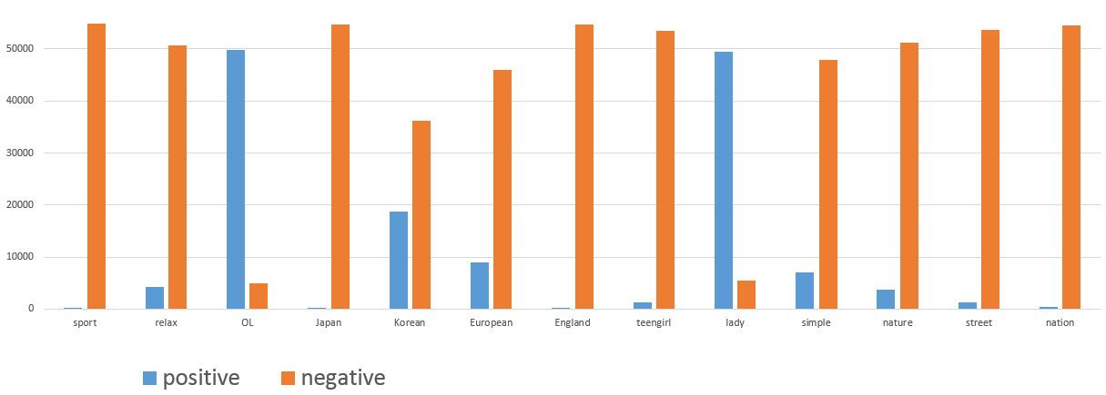
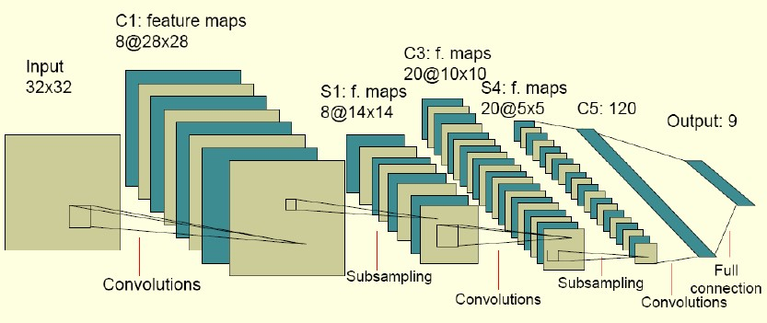
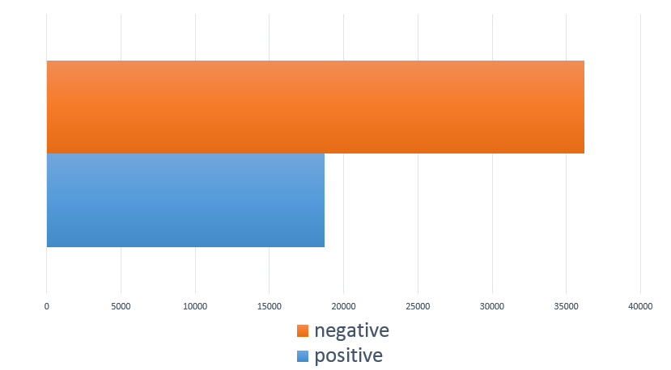
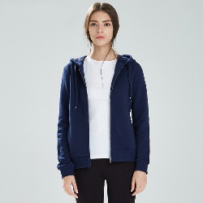
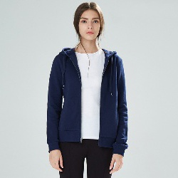
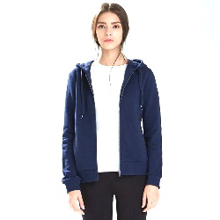
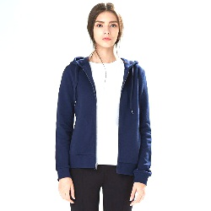
02
方法介绍
面对的问题及解决方案
降采样
代价敏感的学习
数据増广
从中随机抽取与少类别相同数量的样本
使用带权重的损失函数，增大少类样本对损失的贡献
$$Loss=−\left(yln\left(p\right)+\left(1−y\right)ln⁡(1−p)\right)$$
任务本身的抽象性
样本标签数量不均衡
可通过改变各类样本在损失函数中的权重来控制不同类样本对损失的贡献
原图
镜像
原图亮度/对比度调整
镜像亮度/对比度调整

Slide 6
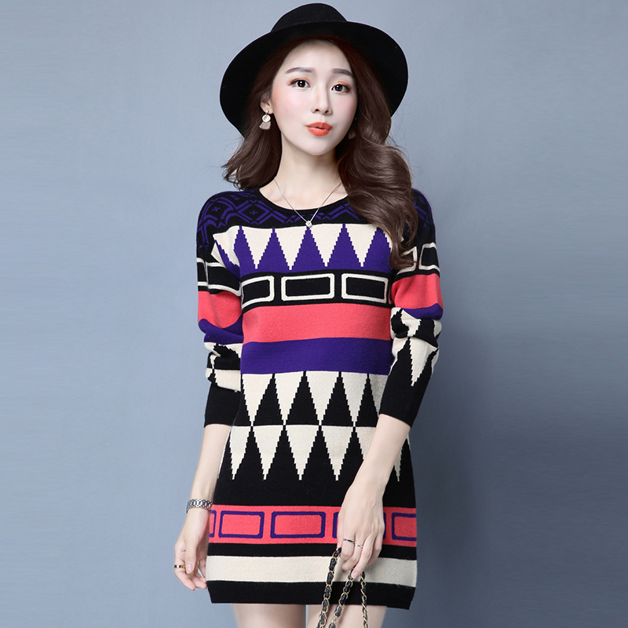
基本网络结构
DenseNet
ResNet
单标签分类网络
AVG
多标签分类网络
13维输出对应当前样本对13个标签属性的概率

Slide 7
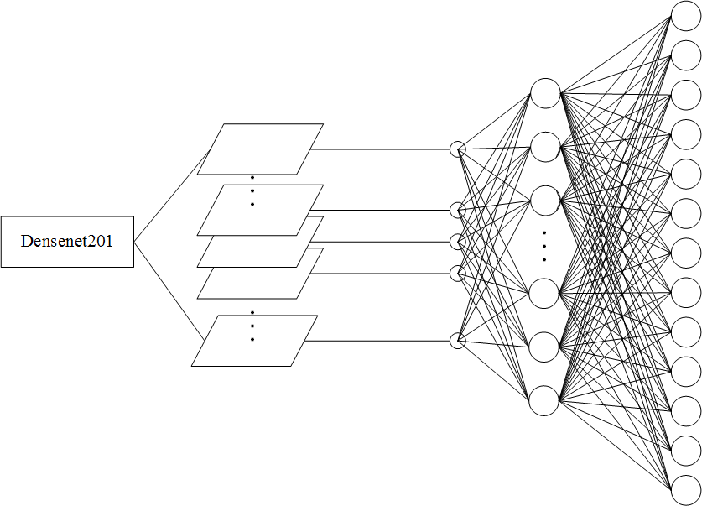
多标签分类网络结构
增加一个隐层

Slide 8
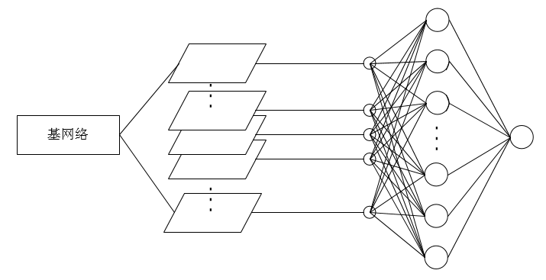
单标签分类网络结构

Slide 9
带权重的损失函数
$$L1=−\left(yln\left(p\right)+\left(1−y\right)ln⁡(1−p)\right)$$
$$L2=−\left(A_{i}y_{i}ln\left(p_{i}\right)+B_{i}\left(1−y_{i}\right)ln⁡(1−p_{i})\right)$$
$$L3=−∑_{i=1}^{13}\left(A_{i}e^{\left(1−p_{i}\right)}y_{i}ln\left(p_{i}\right)+B_{i}e^{p_{i}}\left(1−y_{i}\right)ln⁡(1−p_{i})\right)$$

Slide 10
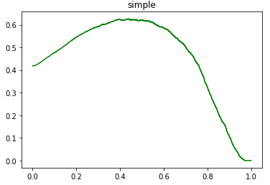
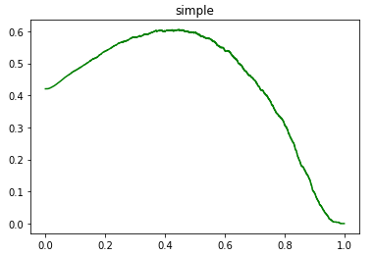
决策阈值
用验证集估计最佳阈值
“简约”标签验证集阈值—F2-score曲线
“简约”标签测试集阈值—F2-score曲线

Slide 11
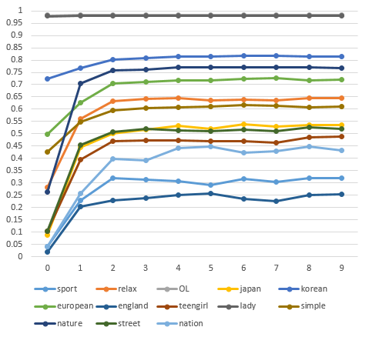
模型训练
运算设备 | 两块GTX1080Ti
数据处理 | Resize250*250 + 归一化处理
训练集/验证集 | 45000张/9908张
批量大小 | 46
网络预训练 | 基网络densenet201在imagenet上进行预训练
优化算法 | Adam
权值衰减系数 | 10^-3
学习率 | 前两轮10^-5，后七轮10^-6
 | 运动 | 日系 | 英伦 | 少女 | 简约 | 街头 | 民族
多标签网络 | 0.32 | 0.53 | 0.25 | 0.48 | 0.61 | 0.51 | 0.43
单标签多网络融合 | 0.4 | 0.53 | 0.30 | 0.48 | 0.64 | 0.55 | 0.49

Slide 12
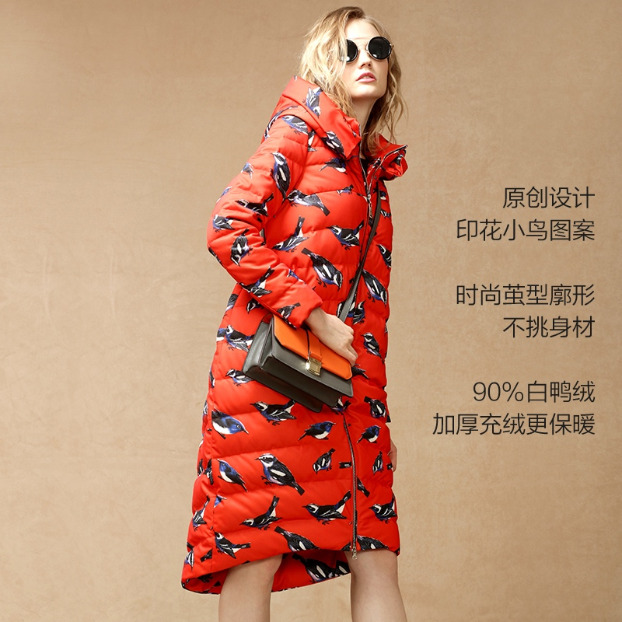
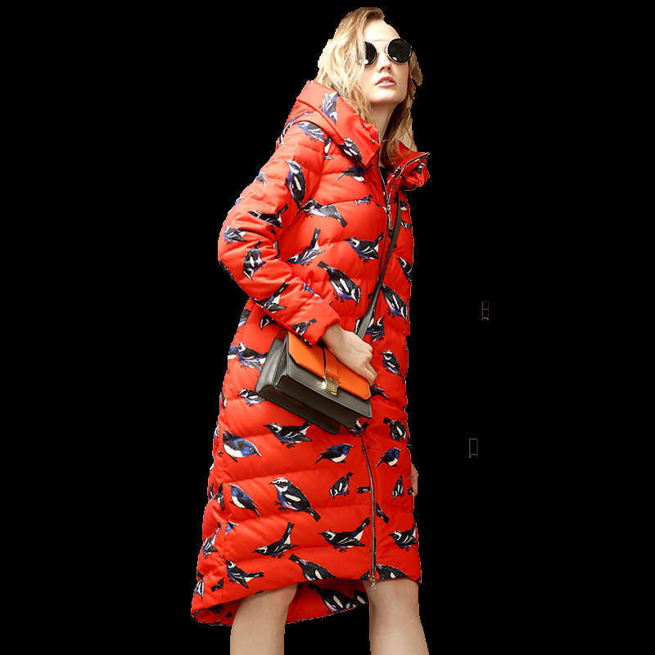
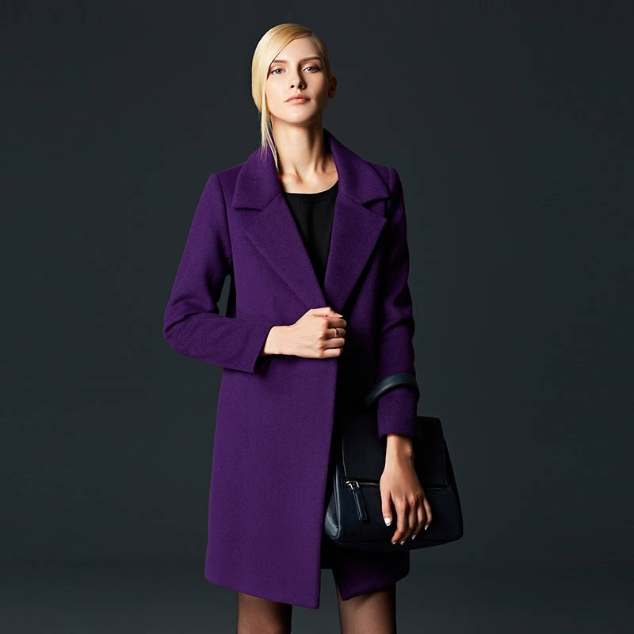
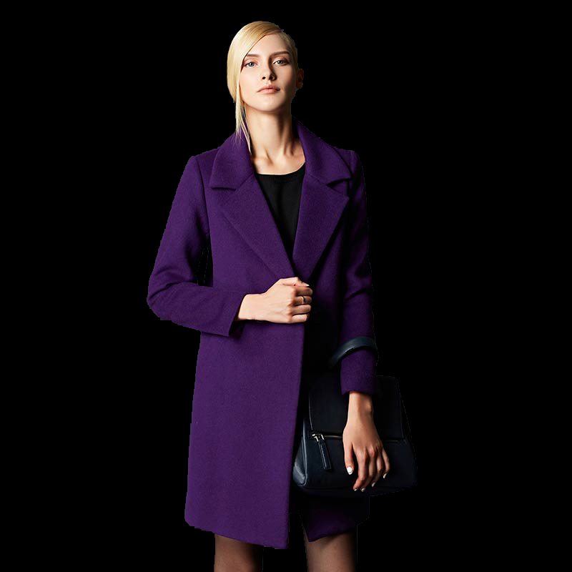
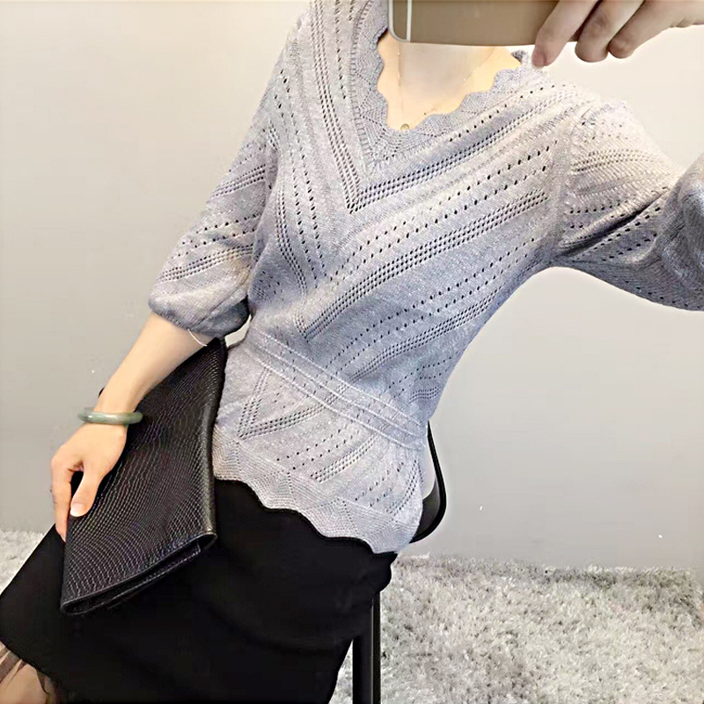
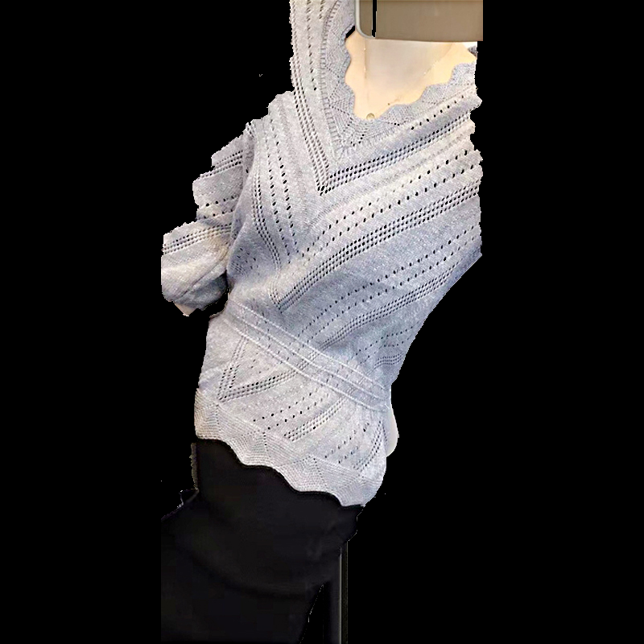
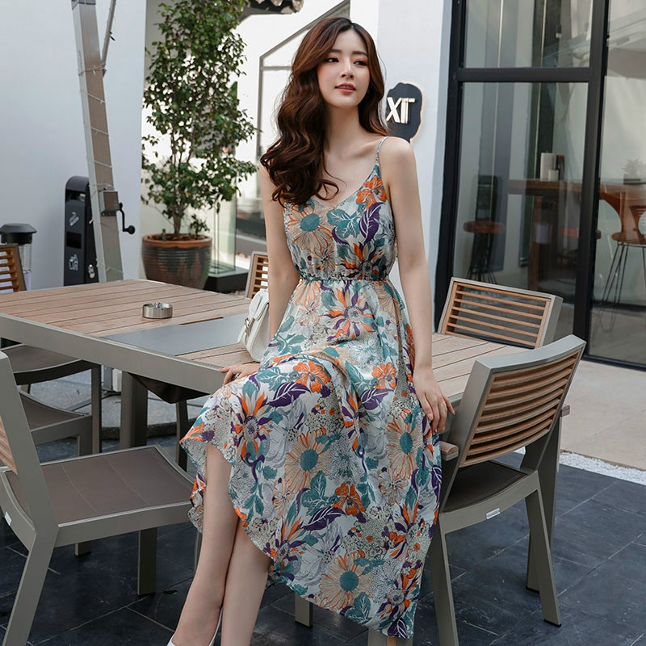
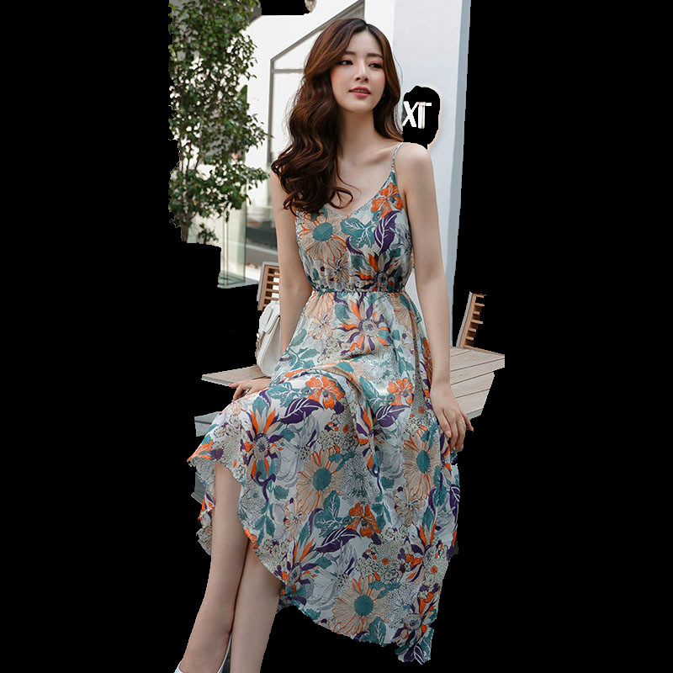
03
存在的问题
数据预处理不足
在整个过程中几乎没有对图像进行筛选和处理，我们尝试过用grabcut去除背景但效果不佳

Slide 13
标签 |  | sport | relax | OL | Japan | Korean | European | England | teengirl | lady | simple | nature | street | nation
 | 数量 | 104 | 4292 | 49893 | 262 | 18722 | 8882 | 197 | 1356 | 49389 | 7094 | 3712 | 1249 | 361
sport | 104 | 100% | 98% | 1% | 0% | 1.90% | 5.80% | 1.90% | 9.60% | 0.90% | 3.80% | 0% | 20% | 0%
relax | 4292 | 2.38% | 100% | 0.23% | 0.44% | 11.04% | 9.53% | 2.77% | 22.74% | 5.45% | 20.85% | 2.61% | 28.08% | 0.23%
OL | 49893 | 0% | 0.02% | 100% | 0.33% | 36.39% | 16.77% | 0.15% | 0.39% | 97.56% | 12.33% | 6.60% | 0.01% | 0.50%
Japan | 262 | 0% | 7.25% | 62.21% | 100% | 0% | 0.38% | 0% | 33.21% | 62.98% | 17.18% | 11.07% | 0.38% | 0%
Korean | 18722 | 0.01% | 2.53% | 96.97% | 0% | 100% | 0.03% | 0.06% | 0.74% | 97.09% | 3.31% | 6.84% | 0.71% | 0.21%
European | 8882 | 0.07% | 4.60% | 94.18% | 0.01% | 0.06% | 100% | 0.30% | 0.89% | 94.33% | 6.03% | 5.04% | 1.72% | 0.05%
England | 197 | 1.02% | 60.41% | 38.07% | 0% | 5.58% | 13.71% | 100% | 5.58% | 34.52% | 4.57% | 0.51% | 26.40% | 0%
teengirl | 1356 | 0.74% | 71.98% | 14.23% | 6.42% | 10.25% | 5.83% | 0.81% | 100% | 0.74% | 4.28% | 2.36% | 11.50% | 0.07%
lady | 49389 | 0% | 0.47% | 98.55% | 0.33% | 36.80% | 16.96% | 0.14% | 0.02% | 100% | 12.28% | 7.26% | 0.01% | 0.70%
simple | 7094 | 0.06% | 12.62% | 86.75% | 0.63% | 8.73% | 7.56% | 0.13% | 0.82% | 85.49% | 100% | 0.49% | 1.04% | 0.11%
nature | 3712 | 0% | 3.02% | 88.69% | 0.78% | 34.51% | 12.07% | 0.03% | 0.86% | 96.63% | 0.94% | 100% | 0.62% | 5.04%
street | 1249 | 1.68% | 96.48% | 0.56% | 0.08% | 10.57% | 12.25% | 4.16% | 12.49% | 0.56% | 5.92% | 1.84% | 100% | 0.08%
nation | 361 | 0% | 2.77% | 68.70% | 0% | 10.80% | 1.11% | 0% | 0.28% | 95.57% | 2.22% | 51.80% | 0.28% | 100%
没有充分利用标签之间的关系

Slide 14
模型融合增加了计算量
模型融合提高性能的同时会大大增加整体的计算量，在实际情景中需要在性能的提升和增加的成本之间进行权衡

Slide 15
The End
PPT模板下载：www.1ppt.com/moban/ 行业PPT模板：www.1ppt.com/hangye/
节日PPT模板：www.1ppt.com/jieri/ PPT素材下载：www.1ppt.com/sucai/
PPT背景图片：www.1ppt.com/beijing/ PPT图表下载：www.1ppt.com/tubiao/
优秀PPT下载：www.1ppt.com/xiazai/ PPT教程： www.1ppt.com/powerpoint/
Word教程： www.1ppt.com/word/ Excel教程：www.1ppt.com/excel/
资料下载：www.1ppt.com/ziliao/ PPT课件下载：www.1ppt.com/kejian/
范文下载：www.1ppt.com/fanwen/ 试卷下载：www.1ppt.com/shiti/
教案下载：www.1ppt.com/jiaoan/
字体下载：www.1ppt.com/ziti/
Thank You

